Slide 1

Data science Portfolio Tamilselvan Tamilmani Masters in Applied Data science Syracuse university
380487108
https://github.com/tamtam0/datascience_portfolio

Slide 2

Agenda
Introduction
Course Reflection
Data science Using R
Statistical Methods for Data Science
NLP & Text Mining
Marketing Analytics
Big Data Analytics
Future Outlook

Slide 3
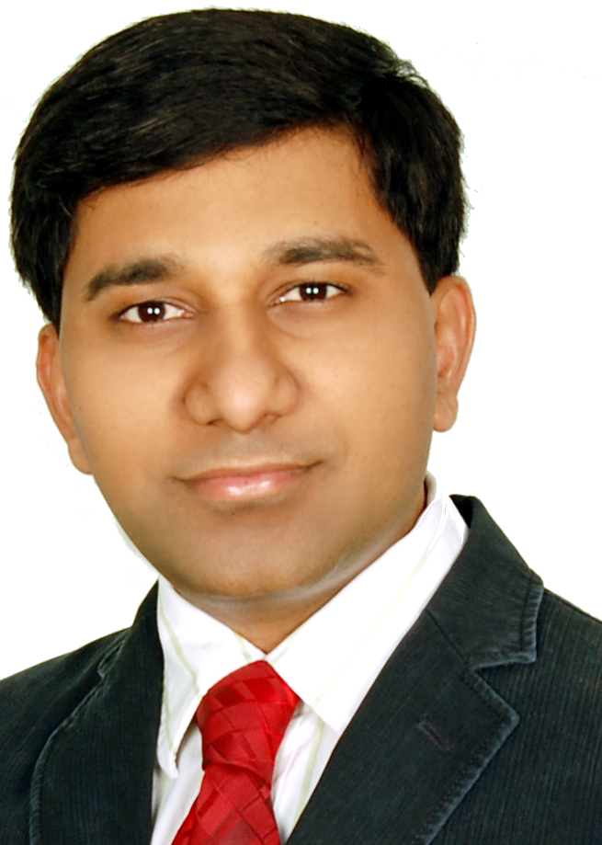
Introduction
I am Tamilselvan Tamilmani, you can call me as Tamil. I work as a ML Architect.
Notes:
I build ML and data systems that productionizes machine learning models. My background is in programming, and I have been programming professionally for the past 17 years and am well versed in Java, Python, javascript, Scala. I was already using map-reduce and spark on my day-to-day job.

Slide 4
Data science Using R
Introduction to Data science
Business Analytics
Data Mining
Information Visualization
Above four courses systematically introduced us to conduct data analysis using R.
It allowed me to learn R language and practice the data science topics specified on the right
Data Collection & Sampling
Data Exploration & Visualization
ANNOVA
Association Rule Mining
Univariate & Multivariate Regression and Diagnostics
Sensitivity Analysis
Classification (Decision Tree, Naïve Bayes, SVM, Random Forest)
Clustering Analysis ( k-Means, kNN, HAC)
Logit & Probit Models
Perceptron & Neural Networks
Notes:
all four taught predominantly in R
I already do a lot of data collection, but this helped me organize the data for modeling, like the observation format.
Also, how to explore the data visually using ggplot, which became my favorite visualizing library. It gave me a structured way to approach the information visually.
and how to approach the data statistically using basic variance techniques like ANNOVA.
It introduced me how to do regression analysis, diagnose the models using various tests like colinearity to remove dependent variable Heteroscedasticity etc,
and interpret the models using tools like sensitivity analysis.
It helped me understand and run classification models like decision trees random forests.
Gave an in-depth look at unsupervised models, clustering, and the associated distance measures.
It introduced binomial models like logit and probit and their extension to perceptrons and neural nets.
In essence, it gave me full coverage of all the data science models.
And the visualization course gave me the necessary tools to communicate my results effectively to business.

Slide 5

Neural Net model for Loan Approval prediction
GGPLOT EDA showing possible author in federalist papers
Notes:
in the case of federalist paper to identify the author, the ggplot helped visually tell our intuition easily

Slide 6
Statistical Methods for Data Science
Data Analysis and Decision Making
Quantative Reasoning
The above two courses enabled me to define business problems and select appropriate statistical techniques listed on the right for a given business problem.
It introduced an additional Bayesian technique to explore it in casual way
Cross-Products/Pearson Product-Moment Correlation
Hypothesis Testing
Confidence Intervals
Categorical Data Analysis
Normal & Binomial distribution
Process Control Charts -X-bar/R, ImR
Timeseries Analysis
Bayesian Inference
Monte Carlo Methods
Notes:
these courses are foundational and gave me a deep understanding of the stats behind the mdoels and one of them bayesian inference became my area of interest, we will disucss this in my future outlook more
It gave me a tool to define a business problem and measure its success

Slide 7
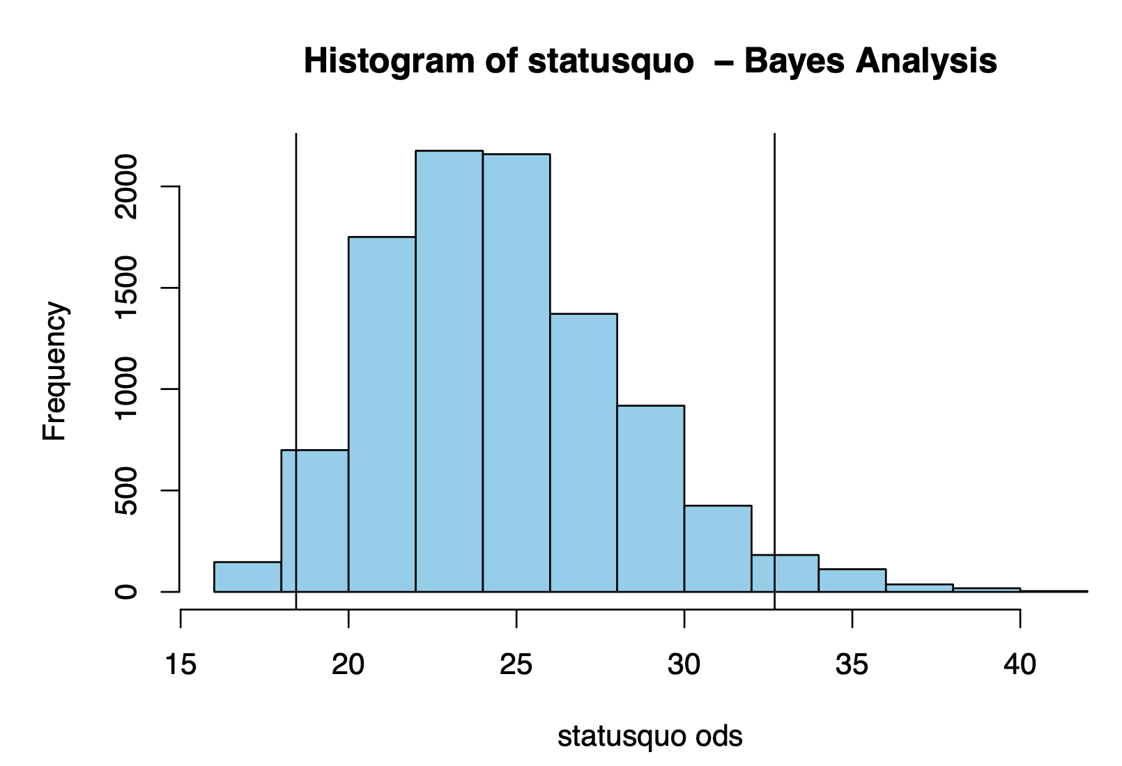
Hypothesis test disproving a process outcome
Bayesian Analysis – status quo in winning an election
Notes:
It gave me a tool to define a business problem and measure its success

Slide 8
NLP & Text Mining
Text Mining
Natural Language Processing
Above two courses enabled us to analyze un-structured data like free form text and get insights from the data using the approached specified in the right
Enable me to get insights from text like the underlying sentiment and the topics.
Corpus Statistics
Language Modeling
Parts-of-Speech Tagging
Context-Free-Grammar
Comparative & Trend Analytics
Text Classification - Sentiment
Scikit-learn & NLTK
Document Clustering & Topic Modeling
Bias in AI
Notes:
I have alredy been using pre trained nlp models like BERT in production
this course gave me a good history of where the text analytics started and evolved and gave me more oprions for my text absed feature engineering

Slide 9
Work from Home topics before and after COVID outbreak

Slide 10
Marketing Analytics
This specialized course enabled me to develop
marketing strategies r
resource allocation decisions
It gave me tools to quantitative analysis like the ones specified on the right
Marketing Resource Allocation
Segmentation using k-means
Price Elasticity
Statistical vs Economic significance
Customer Lifetime Value
Propensity models
Market Share Prediction
Churn Prediction
Utility Theory
Conjoint Analysis
Cross-Selling
Marketing Experiments
Marketing-Mix models
Notes:
the main reason i took this elective is to get an in depth knowledge about using the models in real world application

Slide 11
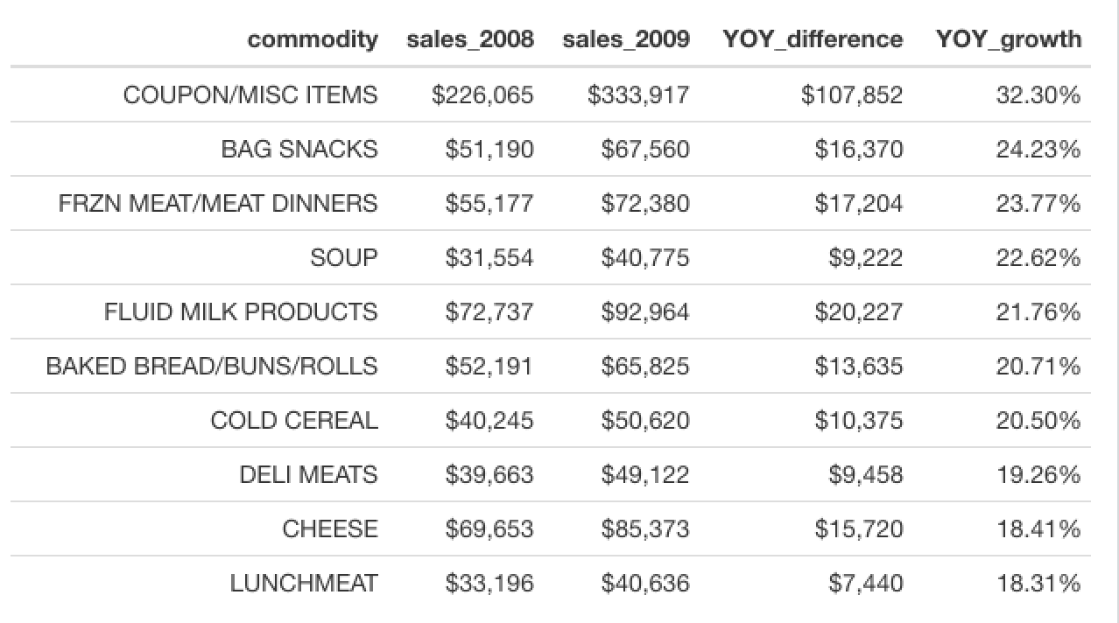
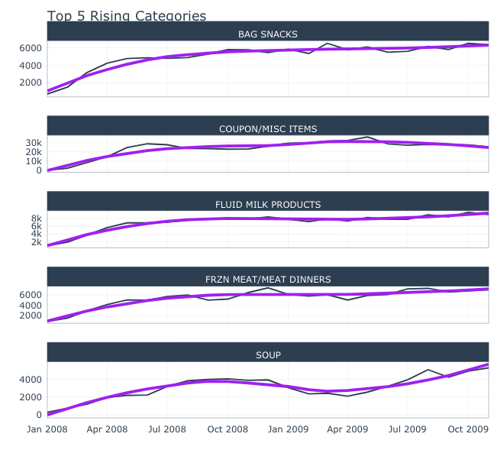
Growing Categories for High CLV Customers

Slide 12
Big Data Analytics
This courses enabled us complete the entire lifecycle of data science, from collecting data to delivering insights
The overall topics are summarized on the right
This course deepened my understanding of Neural Networks
Pushed me to attempt a time series problem on a massive scale
Python & Spark
Data Review
Model Review
Code Review
Consumer preference
Evaluation Methods
Forecasting – ARMIA
Poisson & Negative Binomial Distributions
Decision Trees & Random Forest
Neural Networks
Convolution Neural Networks

Slide 13
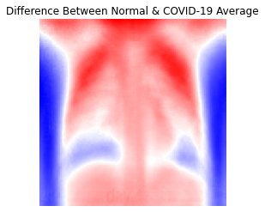

Dense Neural network predicting covid from x-ray images with 100% accuracy

Slide 14
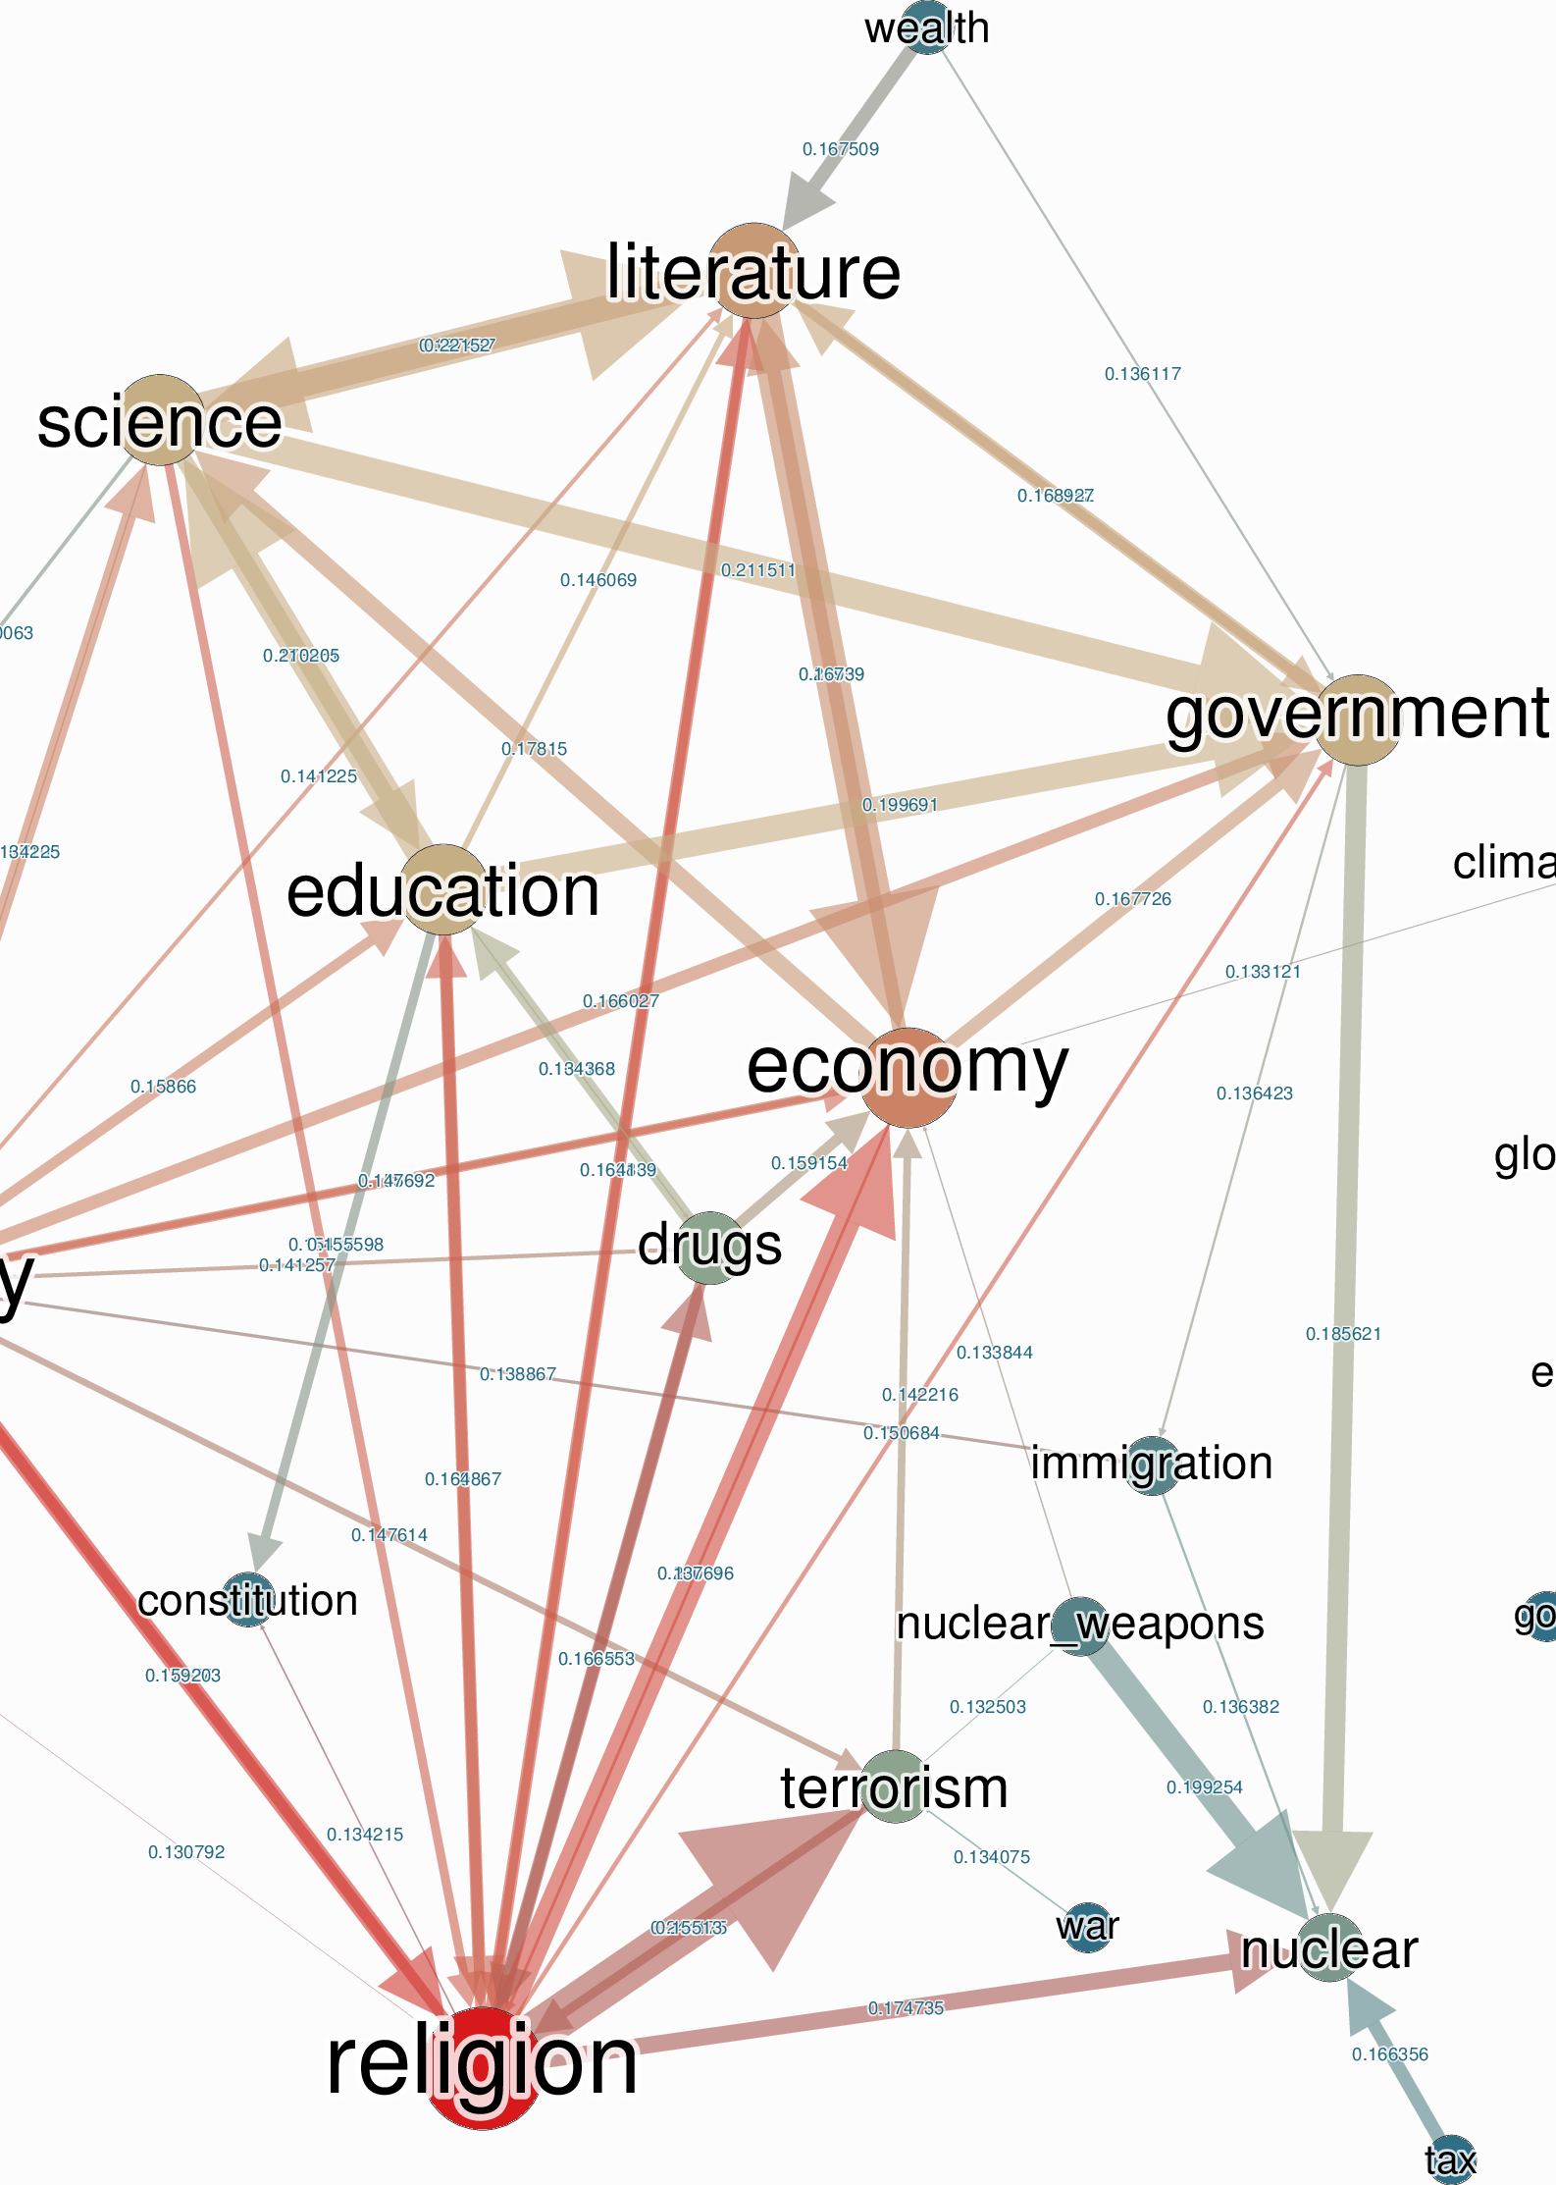
Future outlook
Bayesian Inference – Causality
Deep Neural Networks on PyTorch

Slide 15
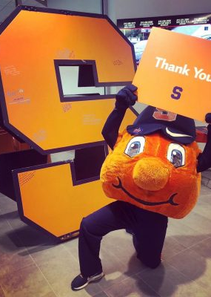
Thank you
Professor Krudy’s hands on approach to R made language learning easy
Professor Pendelberry patiently answered all my questions
Professor Bolton set up a high bar on storytelling part
Professor Gates set up the highest bar in terms of written report
Professor Ramamurthy took me through the journey with marketing
Professor Fox made the class competitive and fun
Professor Larche made the class interactive
Professor Block made me fall in love with Bayesian
Professor Avrneli helped me in the financial analytics
Finally Professor Stinnet helped me to put together this portfolio

Slide 16

references
Bayesian Inference
https://google.github.io/CausalImpact/CausalImpact.html
https://github.com/quantumblacklabs/causalnex/
Deep Neural Networks on PyTorch
https://pytorch.org/

